Slide 1
Flow-based Process: Intraday Capacity Calculation (IDCC)
Adrian Curtze-Rodriguez

Slide 2
Agenda
Aim and goal of TSO regarding CrossZonalCapacities
Process overview DACC & IDCC
IDCC in detail
Publication locations
Key numbers and figures

Slide 3
Aim and goal of TSO regarding CrossZonalCapacities
 | Core
 | Nordic
 | Further Bidding Zones
Accordance with CACM Regulation
Efficient Cross Border Allocation
Higher integration of national electricity markets
IDCC process started on May 28th 2024
Simplified Capacity Calculation regions
Intraday Capacity Calculation

Slide 4
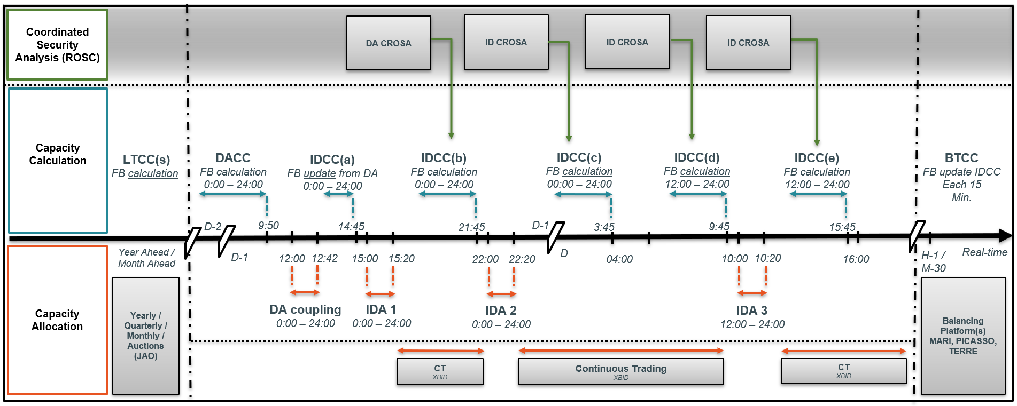
Process overview DayAheadCapacityCalculation and IntraDayCapacityCalculation
Starting from Day-Ahead Timeframe, a repetitive loop from Capacity Calculation, to Allocation and afterwards Security Analysis starts.
Core CCR Perimeter
00:00 – 24:00
12:00 – 24:00
18:00 – 24:00
04:30
External (MCSC, JAO..)

Slide 5
IntraDayCapacityCalculation in detail
Process name | Used grid model | Updated timeframe | Provision of capacities to the market | Subsequent allocation process
IDCC(a) | D2CF | 00:00-24:00 | D-1 15:00 | IDA1 + Continuous trade
IDCC(b) | DACF | 00:00-24:00 | D-1 22:00 | IDA2 + Continuous trade
IDCC(c) | IDCF | 06:00-24:00 | D 04:30 | Continuous trade
IDCC(d) | IDCF | 12:00-24:00 | D 10:00 | IDA3 + Continuous trade
IDCC(e) | IDCF | 18:00-24:00 | D 16:00 | Continuous trade

Slide 6
IntraDayCapacityCalculation in detail
Initial delivery
Initial FB calculation
Validation
Final ATC extraction
IDCC (b-e) process main steps
Different to DayAhead
no minRam adjustment or LongTermAllocation inclusion

Slide 7
IntraDayCapacityCalculation in detail
Initial delivery
Initial FB calculation
Validation
Final ATC extraction
IDCC (b) as example
IDCC (b-e) process main steps
Required Inputs which are delivered
Critical Network Elements Contingencies
Common Grid Model
Generation and Load Shift Keys
Allocation Constraints
Already Allocated Capacity
External Constraints

Slide 8
IntraDayCapacityCalculation in detail
Initial delivery
Initial FB calculation
Validation
Final ATC extraction
IDCC (b) as example
IDCC (b-e) process main steps
CNEC | RAM | Fmax | FRM | F_{i} | IVA | PTDF A->B | PTDF C->D | PTDF E->F
1 | 800 | 1000 | 100 | 100 |  | 0,12 | 0,10 | 0,04
2 | 700 | 1000 | 100 | 200 |  | 0,15 | 0,12 | 0,20
3 | 600 | 1000 | 100 | 300 |  | 0,02 | 0,16 | 0,18
4 | 500 | 1000 | 100 | 400 |  | 0,3 | 0,25 | 0,2
5 | 500 | 1000 | 100 | 400 |  | 0,15 | 0,03 | 0,09
6 | 600 | 1000 | 100 | 300 |  | 0,18 | 0,09 | 0,21
7 | 700 | 1000 | 100 | 200 |  | 0,23 | 0,19 | 0,28
8 | 500 | 1000 | 100 | 400 |  | 0,01 | 0,03 | 0,02
9 | 500 | 1000 | 100 | 400 |  | 0,02 | 0,04 | 0,03
10 | 700 | 1000 | 100 | 200 |  | 0,01 | 0,04 | 0,04
11 | 600 | 1000 | 100 | 300 |  | 0,03 | 0,01 | 0,01
Exchange A→B
2
3
1
4
Exchange A→C
7
5
6
Only CNECs with PTDF >5% are used further

Slide 9
IntraDayCapacityCalculation in detail
Initial delivery
Initial FB calculation
Validation
Final ATC extraction
IDCC (b) as example
IDCC (b-e) process main steps
CNEC | RAM | Fmax | FRM | F_{i} | IVA | PTDF A->B | PTDF C->D | PTDF E->F
1 | 800 | 1000 | 100 | 100 |  | 0,12 | 0,10 | 0,04
2 | 700 | 1000 | 100 | 200 |  | 0,15 | 0,12 | 0,20
3 | 600 | 1000 | 100 | 300 |  | 0,02 | 0,16 | 0,18
4 | 500 | 1000 | 100 | 400 |  | 0,3 | 0,25 | 0,2
5 | 500 | 1000 | 100 | 400 | 100 | 0,15 | 0,03 | 0,09
6 | 600 | 1000 | 100 | 300 |  | 0,18 | 0,09 | 0,21
7 | 700 | 1000 | 100 | 200 |  | 0,23 | 0,19 | 0,28
Exchange A→B
2
1
3
4
Exchange A→C
Local Validation
Due to the reduced timings in IDCC compared to DACC, in ID only a short local validation is possible (40 minutes max).
Reminder Objective:
Identify and apply measures for resolving the potential violation of operational security given by the flow-based domain results
7
5
6

Slide 10
IntraDayCapacityCalculation in detail
Initial delivery
Initial FB calculation
Validation
Final ATC extraction
IDCC (b) as example
IDCC (b-e) process main steps
CNEC | RAM before AAC shift | Final RAM
1 | 800 | 750
2 | 700 | 650
3 | 600 | 600
4 | 500 | 550
5 | 400 | 450
6 | 600 | 650
7 | 700 | 700
Exchange A→B
2
1
3
Shift to the AAC
4
Exchange A→C
Final Computation including shift to latest AACs
During the IDCC process the Intraday market remains open and market participants can continue to trade.
To ensure that the ID cross border trades that took place during the IDCC process are considered the Final FB domain is shifted to the “AAC” point, which stands for Already Allocated capacities
7
5
6

Slide 11
IntraDayCapacityCalculation in detail
Initial delivery
Initial FB calculation
Validation
Final ATC extraction
IDCC (b) as example
IDCC (b-e) process main steps
CNEC | Final RAM
1 | 750
2 | 650
3 | 600
4 | 550
5 | 450
6 | 650
7 | 700
Border | ID ATC
A→B | 400
B→A | 450
A→C | 300
C→A | 350
Exchange A→B
ID ATC Extraction
2
ID ATC Domain
1
ID ATC A→B
3
AAC
ID ATC A→C
4
Exchange A→C
ATC Extraction
Reminder: The ID market (both Continuous Trading on XBID as the ID auctions) are not compatible with FB domains. Thus, FB domains need to be converted to ATC/NTCs.
This is done via an iterative algorithm that tries to extract the largest ATCs possible within the FB domain. ➔ i.e. the rectangle should not go outside the FB domain.
7
5
6

Slide 12
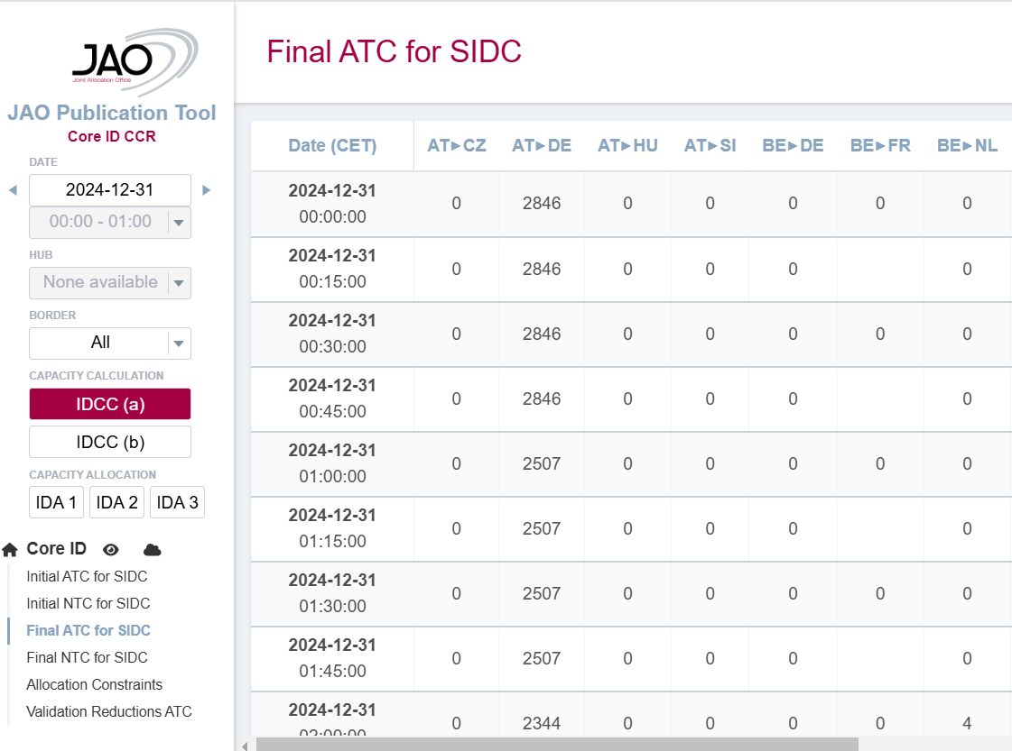
Information sources – JAO publication tool
https://publicationtool.jao.eu/coreID/

Slide 13
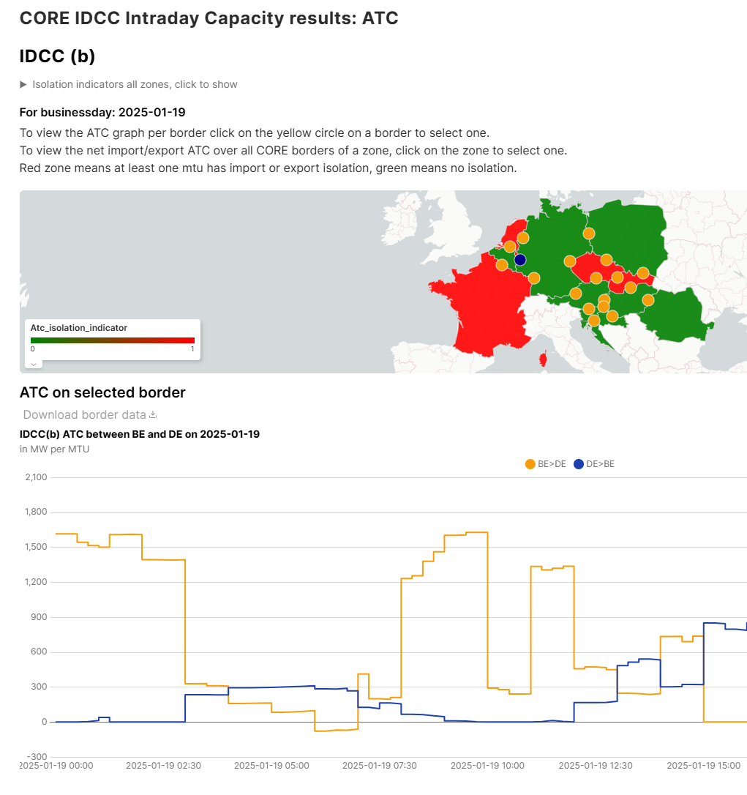
Information sources
Credit goes to Frank Boerman: https://data.boerman.dev/ & https://idcc.coreflowbased.eu/

Slide 14
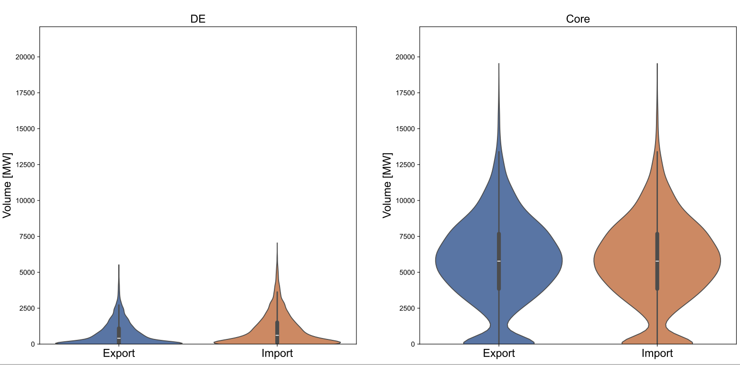
Distribution of Hourly positive NTC increase via IDCC (b) in 2024
*only positive [NTC (b) - NTC (a)] values are taken into account

